Slide 1
Mobile Backend as a Service MBaaS
Pravin Y Pawar

Slide 2
MBaaS
Pretty much similar to BaaS!
BaaS can be used for web projects or mobile projects
Termed as Mobile backend as a service (MBaaS) when used for mobile development
Allows you to use pre-developed backend stored in the cloud
Backend includes unified functionality most applications use:
push notifications
social networks integrations
cloud storage
messaging
analytics etc.

Slide 3
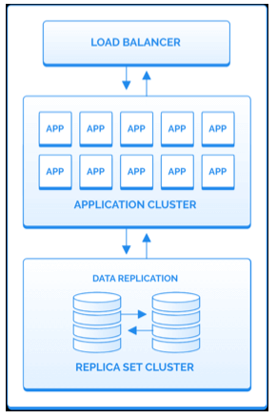
MBaaS / BaaS Architecture
Three Tier
The first layer - Database
Is the foundation and contains the database servers
A database cluster has at least two servers to replicate data and a backup routine to retrieve data
The second layer - Application
Is the application cluster and contains multiple servers to process requests
Quantity of servers fluctuates throughout the time of the day
Auto-scaling procedures are necessary to fulfill the correct number of servers
The third layer - Gateway
Connects the application servers to the Internet
Composed of load balancers and CDNs
Image source : Back4App

Slide 4

MBaaS Providers
Back4App
Offers a comprehensive product that uses several open-source technologies
NodeJS, Parse Server, and MongoDB
Uses a simple approach
Help developers with resources needed to create scalable applications without the hassles of reinventing the wheel
Features: The platform features include data model, push-notifications, REST and GraphQL APIs, login, authentication data backup, multiple SDK, non-technical administration panel, cloud functions, reset passwords, and CLI,
Open Source
Cloud-Hosting or self hosting possible
Private Cloud and on-premises deployment possible
Professional Services: Solutions Architect, Consulting, and enterprise plans

Slide 5

MBaaS Providers
Parse
Excellent framework for expediting mobile application development
Facebook converted the project to open source in 2016
Features: JSON-like data management console, social-login (Facebook, Apple, Twitter, WeChat, GitHub, Google, etc.), password rest, integration with AWS file storage, push-notifications, SDKs (GraphQL, Rest, Javascript, iOS, Android, etc.)
Open Source
Cloud-Hosting Not possible, but Self-Hosting possible
Remarks: This framework has over 16k stars and 4k forks on Github

Slide 6
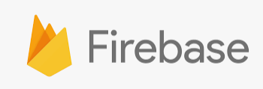
MBaaS Providers
Firebase
Versatile platform for mobile and web application development from Google
Developers can create serverless apps and send push notifications to connected mobile devices
Highly secure and efficient platform for scalability
Unique feature of Firebase is its realtime database - makes it an excellent choice for developing apps with live chat
Features: The main features include realtime database, phone authentication, storage, cloud functions, hosting, ML kit, and many other excellent features
Cloud-Hosting possible
Pay as you go pricing model
Support Services: The platform supports case submission.
Remarks: Firebase does neither offer private clouds or enterprise plans.

Slide 7
Thank You!
In our next session:

